Slide 1
Such a CAD! How Evolution of CAD Tools Facilitates Intel’s Microprocessor Design
03/07/2021
Yucheng Jin
University of California, Berkeley
Presentation of the paper
Gelsinger, Patrick, et al. “Such a CAD!.” IEEE Solid-State Circuits Magazine 2.3 (2010): 32-43.

Slide 2
Outline
Abstract
Background: A Brief History of Microprocessors & Intel
Design Environment for the Early x86 Processors (1970s to 1980s)
The 386 Design Environment (1985)
The 486 Design Environment (1989)
Design Environment for Pentium Processors (1993)
Discussion & Trends

Slide 3
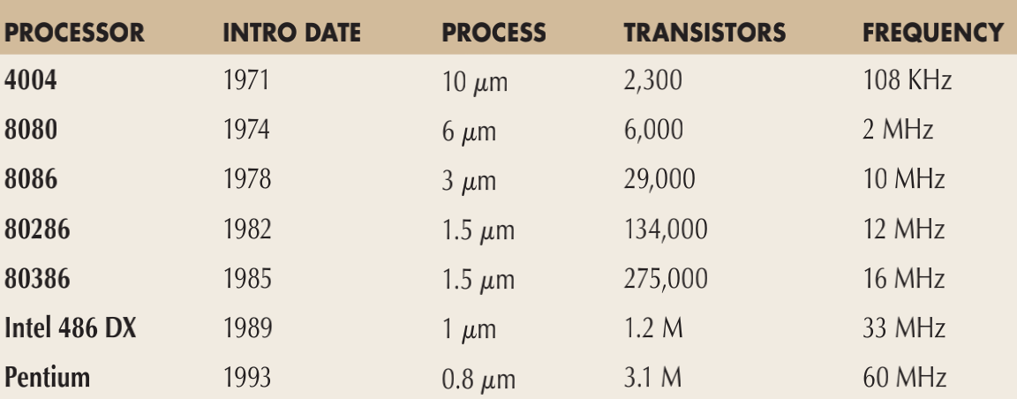
Abstract
This paper is the story of the coevolution of design methodologies, practices, and CAD tools in Intel’s design environment as it coped with increasing complexity in the turbulent 1980s and up through recent years.
Table 1. Intel Processors, 1971-1993
Image Source: Gelsinger, Patrick, et al. “Such a CAD!.” IEEE Solid-State Circuits Magazine 2.3 (2010): 32-43.

Slide 4
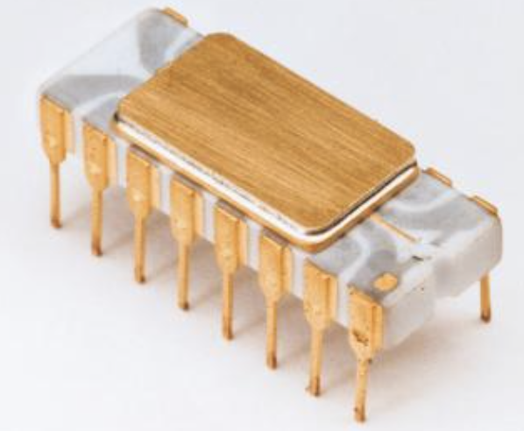
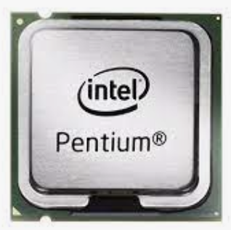
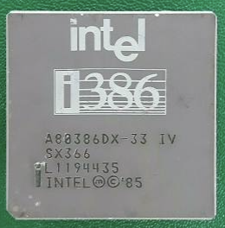
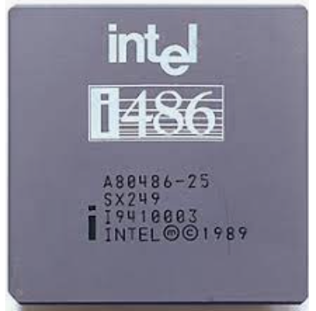
Abstract
Design Environment for
the Early x86 Processors
(4004, 8008, 8080), 1970s to 1980s
The 386 Design Environment,
1985
The 486 Design Environment,
1989
Design Environment for Pentium Processors, 1993
Image Source: Bing.com
Figure 1. Intel Processors

Slide 5
Abstract
At the early stage of the CAD industry, most tools emerged from
Internal development
External university research
A blend of internal work with external tools and research
While there were a lot of corporate-university relationships at that time, none was as prolific as that of Intel with UC Berkeley.
In particular, Alberto Sangiovanni-Vincentelli and his team, which consisted of Robert Brayton, Richard Newton, and many graduate students, had developed a strong partnership with Intel and its microprocessor teams.

Slide 6
Outline
Abstract
Background: A Brief History of Microprocessors & Intel
Design Environment for the Early x86 Processors (1970s to 1980s)
The 386 Design Environment (1985)
The 486 Design Environment (1989)
Design Environment for Pentium Processors (1993)
Discussion & Trends

Slide 7
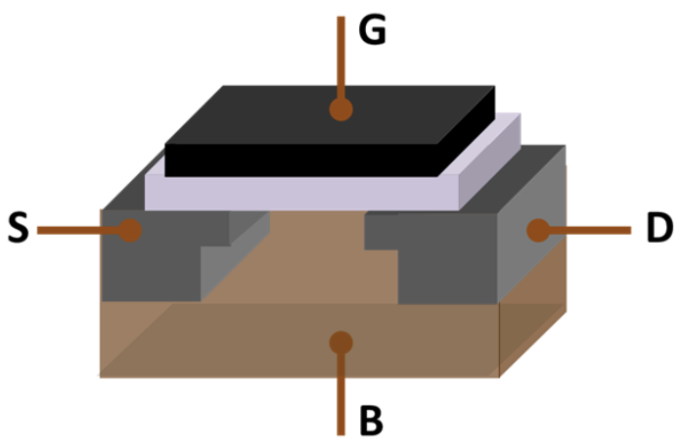
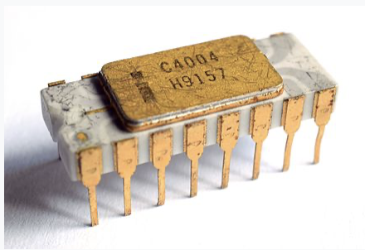
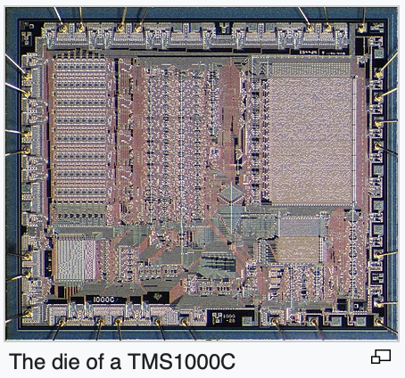
A Brief History of Microprocessors
The development of MOS integrated circuit chips in the early 1960s enabled higher transistor density and lower manufacturing costs.
The first commercially produced microprocessor was the Intel 4004.
Other noticeable early microprocessors include Garrett AiResearch CADC and Texas Instruments TMS1000.
Image Source: Wikipedia
Figure 2. MOSFET, Intel 4004, Texas Instruments TMS1000C

Slide 8
A Brief History of Intel
Founded in Mountain View, California, in 1968 by Gordon E. Moore. Intel stands for Integrated Electronics.
During the 1980s, Intel transformed itself from a semiconductor company into a computer company [1].
Intel’s first product was the 3101 Schottky TTL bipolar 64-bit static random-access memory (SRAM) in 1969.
Intel created the first commercially available microprocessor (Intel 4004) in 1971.
1982: 80286
1985: 80386
1989: Intel 486 DX
1993: Pentium
[1] A. S. Grove. “Only the Paranoid Survive How to Exploit the Crisis Points That Challenge Every Company”. New York: Doubleday, 1996.

Slide 9
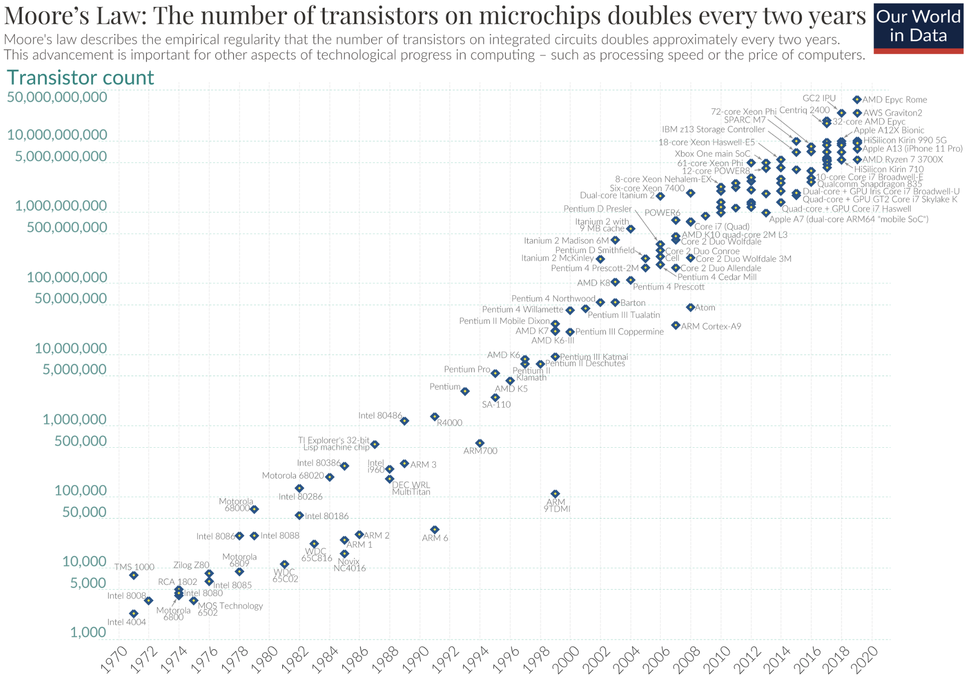
Moore’s Concern
The number of transistors in a dense integrated circuit (IC) doubles about every two years.
In Gordon Moore’s original 1965 paper, he expressed a concern that the growth rate he predicted would not be sustainable because the process of design is too complicated.
How about using computer-aided design (CAD)?
Figure 3. Moore’s Law Semi-log Plot
Image Source: Wikipedia

Slide 10
Outline
Abstract
Background: A Brief History of Microprocessors & Intel
Design Environment for the Early x86 Processors (1970s to 1980s)
The 386 Design Environment (1985)
The 486 Design Environment (1989)
Design Environment for Pentium Processors (1993)
Discussion & Trends

Slide 11
Inherited Tools from Memory Chips
Intel’s initial design environment was formed for memory chip design.
During the 1970s, the primary CAD tools were layout capture and verification tools, used by draftsmen to generate and check mask layouts.
Engineers were doing circuit and logic designs at the transistor level, usually by hand, producing hand-drawn schematics at the transistor level for the layout designers.
However, they also had circuit simulation tools derived from the industry standard SPICE [1] program.
[1] T. Quarles, A. R. Newton, D. O. Pederson, and A. Sangiovanni-Vincentelli. “SPICE 3BI User’s Guide”. Berkeley, CA: Univ. of California Press, Apr. 1987.

Slide 12
SPICE
SPICE is a general-purpose circuit simulation program for nonlinear dc, nonlinear transient, and linear ac analyses.
Circuits may contain resistors, capacitors, inductors, mutual inductors, independent voltage and current sources, four types of dependent sources, lossless and lossy transmission lines (two separate implementations), switches, uniform distributed RC lines, and the five most common semiconductor devices: diodes, BJTs, JFETs, MESFETs, and MOSFETs.
SPICE can simulate and check logic behavior and timing waveforms for small circuits that incorporated up to a few hundred transistors.

Slide 13
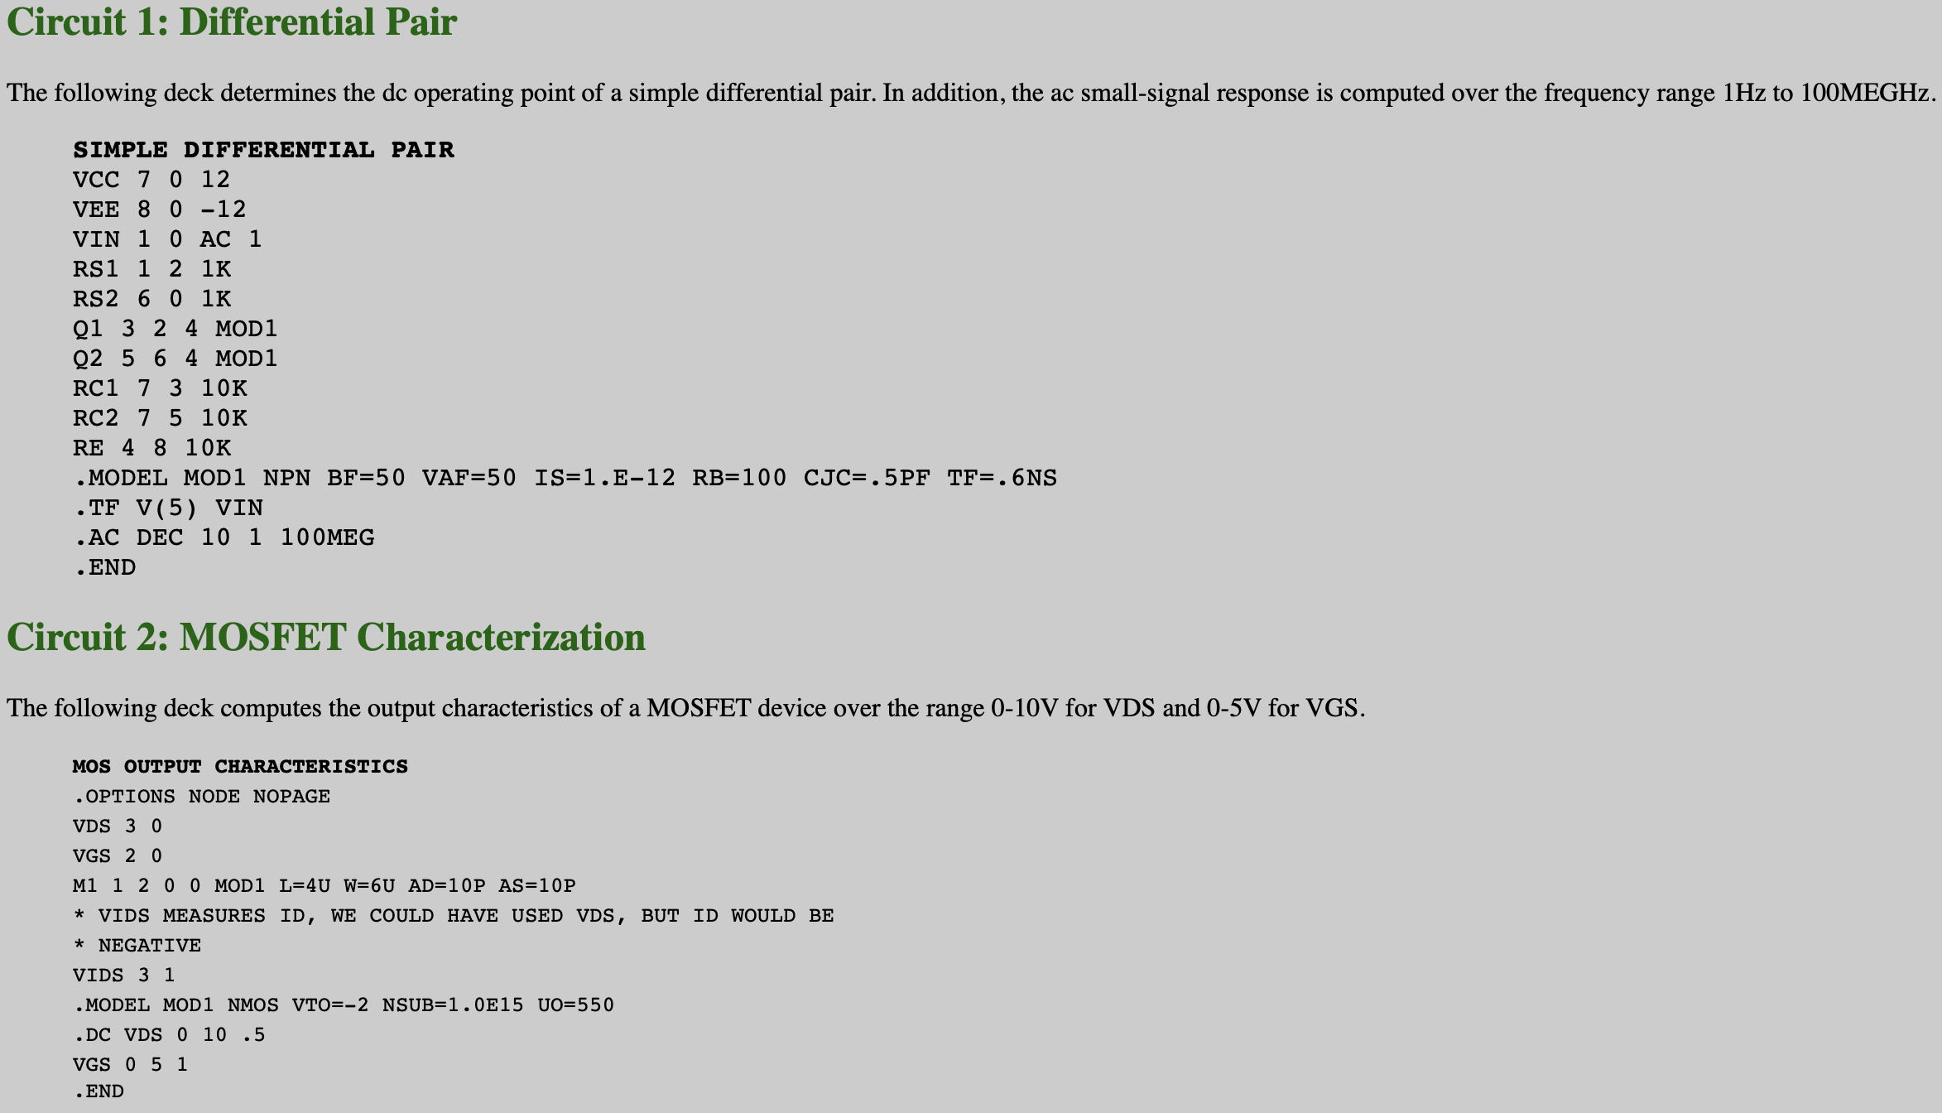
SPICE Examples
Figure 4. SPICE Program Samples
Image Source: http://bwrcs.eecs.berkeley.edu/Classes/IcBook/SPICE/Examples/examples.html

Slide 14
Gate-level vs Transistor-level
Some engineers preferred to perform logic design using gate-level schematics, but this generated some resistance from the layout designers.
They were familiar with transistor representations.
Translating logic gate symbols into transistor structures was not a trivial task. Circuit operation relied on device strength ratios, so each gate symbol had to be accompanied by specific transistor sizes.
In addition, even logic design was performed by engineers at the transistor level (e. g. an implementation optimized with K maps), it was not widely used, because the clever NMOS design tricks typically resulted in superior densities with commensurate complexities.

Slide 15
Evolution of Intel’s Logic Design & RTL Modeling
It became too error-prone to debug logic behavior of processor circuits by hand and too time-consuming to verify the logic behavior by circuit simulation using continuous waveforms.
Register-transfer level (RTL) modeling and simulation by a compiled program in a standard language was made possible because of a strictly synchronous design methodology. The RTL program simulates the circuit behavior at a cycle-by-cycle timing resolution by invoking code for each clock phase in turn.
One of the first RTL models at Intel was developed for the 8087 numeric coprocessor in 1978. It was a FORTRAN program that described the logic behavior of circuits.

Slide 16
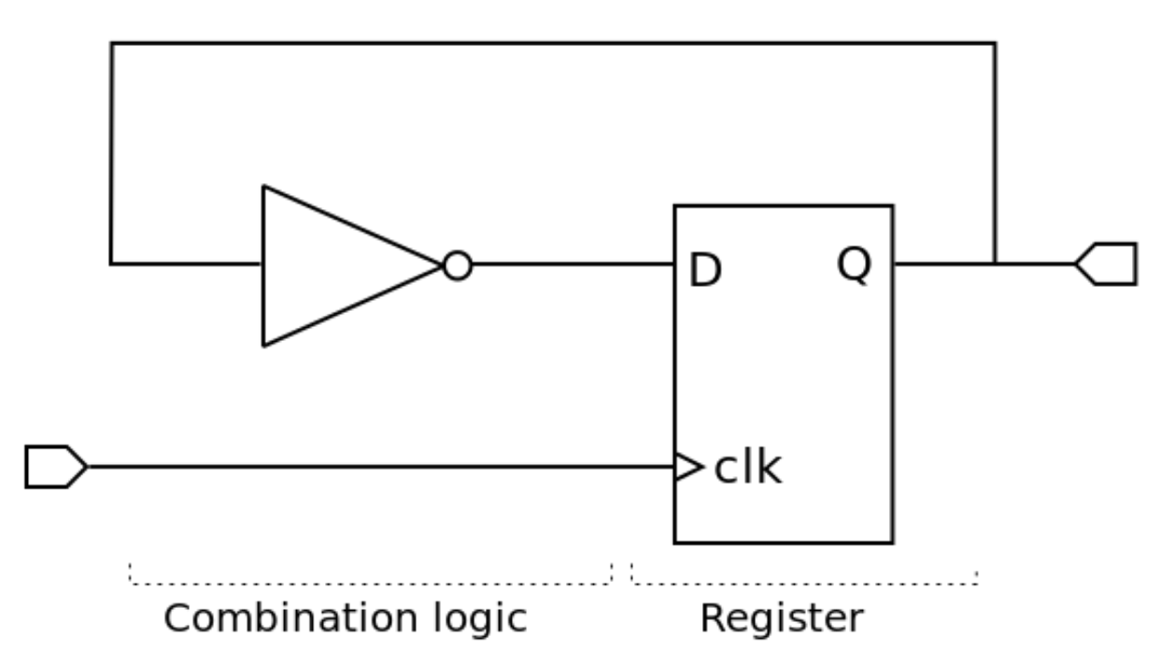
Evolution of Intel’s Logic Design & RTL Modeling
In the 80286 design, the blocks of RTL were manually translated into the schematic design of gates and transistors.
Programmable logic array (PLAs) functions automated the logic minimization process.
Figure 5. A Simple RTL Model
Image Source: Wikipedia

Slide 17
Outline
Abstract
Background: A Brief History of Microprocessors & Intel
Design Environment for the Early x86 Processors (1970s to 1980s)
The 386 Design Environment (1985)
The 486 Design Environment (1989)
Design Environment for Pentium Processors (1993)
Discussion & Trends

Slide 18
Transition from 286 to 386
In moving to the 386 during 1982, the design team quickly ported the 286 design modules to the new design environment as a starting point.
A problem was how to more effectively provide the translation to schematics and the logical representation of the chip.
The objectives were to accelerate the design process, minimize manual translation errors, and handle the rapidly increasing design complexity.
Given these goals, the relationship with Berkeley—and especially with Alberto—quickly became central for Intel. The design manager of the project put Alberto on a consulting contract.

Slide 19
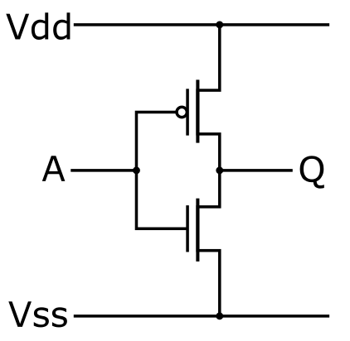
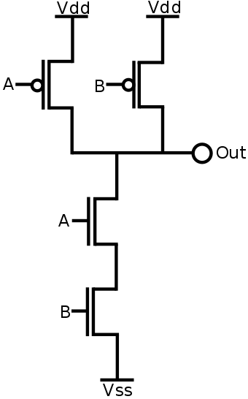
Era of CMOS
With the 386, the era of Complementary Metal-Oxide-Semiconductor (CMOS) began at Intel. CMOS uses complementary and symmetrical pairs of p-type and n-type MOSFETs for logic functions.
Image Source: Wikipedia
Figure 6. CMOS NOT & NAND Logics

Slide 20
A Successful Cooperation
Berkeley tools like Espresso for logic minimization and TimberWolf for simulated annealing of cell placement were used by Intel.
The results were good enough that the design team eliminated all the small PLAs from the 286 and simply converted them to interconnected logic gates.
This made the logic blocks larger, with greater potential for further logic-design optimization.

Slide 21
Outline
Abstract
Background: A Brief History of Microprocessors & Intel
Design Environment for the Early x86 Processors (1970s to 1980s)
The 386 Design Environment (1985)
The 486 Design Environment (1989)
Design Environment for Pentium Processors (1993)
Discussion & Trends

Slide 22
The Challenge of Logic Design for 486
The design for 486 involved the move to a fully pipelined design, the integration of a large floating-point unit, and the introduction of the first on-chip cache. Several aggressive goals were proposed to enable the team to tackle these challenges
A fully automated translation from RTL to layout
No manual schematic design
Multilevel logic synthesis for the control functions
Automated gate sizing and optimization
Inclusion of parasitic elements estimation
Full chip-layout and floor-planning tools
To execute this visionary design flow, the team needed to put together a CAD system that did not yet exist. Once again, they traveled to Alberto.

Slide 23
The Age of Heroes
While the team was working on the 386, academic CAD research was going through a major renaissance at Berkeley.
The original research in CAD there was being combined into the Berkeley Synthesis Project, with a focus on merging the efforts in logic synthesis and layout generation.
Later, Robert Brayton joined the Berkeley faculty full-time in 1987. The three main CAD professors, Alberto, Robert Brayton, and Richard Newton, then joined forces to begin what became a highly prolific period in CAD.
Alberto termed this era “the age of heroes,” a “vibrant era of creativity and expansion.”

Slide 24
Intel’s Hardware Description Language
A major technical challenge the team had to overcome for enabling a direct link from RTL to logic synthesis was the input language for RTL modeling.
The iHDL language filled the bill. Meanwhile, the CAD team in Israel was developing the language compiler.
Berkeley’s creation of a standard intermediate format for logic representation (BLIF) was a key enabler for Intel (and others) to develop higher-level description languages.
Amazingly, Intel didn’t replace iHDL with Verilog until 2005, simply because of its expressive completeness and effectiveness for synthesis.

Slide 25


Intel’s Adaptation of Berkeley Logic Synthesis
The team decided that the RLS system would be based on a tool called Multilevel Logic Interactive Synthesis System (MIS) [1], which was an experimental workbench being developed by Berkeley graduate students.
Figure 7. Robert K. Brayton (Berkeley Professor Emeritus, left) & Pat Gelsinger (Intel CEO, right)
[1] R. K. Brayton, R. Rudell, A. L. Sangiovanni-Vincentelli, and A. R. Wang. “MIS: A multiple-level logic optimization system”. IEEE Trans. Computer-Aided Design Integr. Circuits Syst., vol. CAD-6, no. 6, pp. 1062–1081, Nov. 1987.

Slide 26
Berkeley’s Contribution to Physical Design Automation in RLS
Place-and-route algorithms came from Alberto’s students at Berkeley. TimberWolf used simulated annealing and was directly and heavily used to create optimized placements.
While routers were written for industrial use, the algorithms were heavily based on technology from Alberto: the infamous YACR2 algorithm [1] and the Chameleon multilayer approach [2] by Doug Braun.
[1] J. Reed, A. L. Sangiovanni-Vincentelli, and M. Santomauro. “A new symbolic channel router: YACR2”. IEEE Trans. Computer-Aided Design Integr. Circuits Syst., vol. 4, no. 3, pp. 208–219, 1985.
[2] D. Braun, J. Burns, S. Devadas, K. H. Ma, K. Mayaram, F. Romeo, and A. L. Sangiovanni-Vincentelli. “Chameleon: A new multilayer channel router”. in Proc. 23rd Design Automation Conf., 1986, pp. 495–502.

Slide 27
Complete RLS Flow for Random Logic Synthesis
The combination of all abovementioned tools was stitched together into a system called RLS, which was the first RTL-to-layout system ever employed in a major microprocessor development program.
RLS succeeded because it combined the power of 3 essential ingredients: CMOS, a hardware description language, and synthesis.
At the end of the design, Alberto was featured in a video that Intel distributed worldwide to universities [1]. The video described how microprocessor design was done at Intel and how Intel had revolutionized CAD by working with Alberto’s team.
[1] G. Hill. “Design and development of the Intel 80386 microprocessor”. Video recording. Univ. Video Commun., Stanford, CA, 1988.

Slide 28
Outline
Abstract
Background: A Brief History of Microprocessors & Intel
Design Environment for the Early x86 Processors (1970s to 1980s)
The 386 Design Environment (1985)
The 486 Design Environment (1989)
Design Environment for Pentium Processors (1993)
Discussion & Trends

Slide 29
Design Environment for Pentium Processors
The first Pentium was a superscalar microprocessor design, and the microarchitecture included new features like microcode-based instructions, a 64-bit fast external data bus, and a completely revamped floating-point unit with unprecedented levels of performance.
At 3.1 million transistors, the Pentium required stronger EDA capabilities.
The Pentium design automation (DA) team continued a very deep and effective interaction with Alberto, Richard Newton, and the rest of the Berkeley team.
As a result, Alberto’s group codeveloped logic synthesis programs for the Pentium DA team.

Slide 30
Outline
Abstract
Background: A Brief History of Microprocessors & Intel
Design Environment for the Early x86 Processors (1970s to 1980s)
The 386 Design Environment (1985)
The 486 Design Environment (1989)
Design Environment for Pentium Processors (1993)
Discussion & Trends

Slide 31
Discussion & Trends
At each step of the CAD evolution, higher productivity was enabled by increased automation, which leveraged increasing computational capacity, higher abstraction, higher regularity, more usage of hierarchy, and a more disciplined and restrictive methodology
Using RTL instead of schematics is an example of higher abstraction
Examples of a restrictive methodology include the synchronous design paradigm, the specific iHDL language design for synthesis, the cell library, and static CMOS
Collaboration among Intel, Alberto Sangiovanni-Vincentelli, and UC Berkeley, continues to this day in a broad range of areas of computer architecture, particularly platform-based design.

Slide 32
Thank You for Listening!
Q & A

